Slide 1
Debugging, Validation and Verification

Slide 2
Debugging, Validation and Verification
General Principles
Tools available in Matlab

Slide 3
Setting Up Test Cases
Many times one test case will not be enough
Test all paths through the code
With “if” statements test the “True” path and the “False” path

Slide 4
Setting Up Test Cases
Example:
  if angle > pi
  x=1;
  else
  x=2;
  end
At least two test cases are needed here, one for angle > pi and one for angle < pi (you may also want to test angle = pi to make sure you get the value expected

Slide 5
General Debugging Strategies
Debug individual modules separately
Obtain/Produce data that can be used in the debugging process

Slide 6
Modularized Debugging
Building Blocks should be debugged before tackling main program
Use simple cases and hand calculations to test individual modules

Slide 7
Stubborn Problems
Do all of the steps with hand calculations
Compare each step of the code with your hand calculations
Narrow problem areas
  Divide the section in half and compare to hand calcs
  Determine if problem is above or below
  Continue with process until narrowed in on problem

Slide 8
Debugging a Single Line
Sometimes Matlab will point to a single line as a problem
x=(y/z)*cos(a)*asin(b)
In order to narrow in on the problem, print out all of the variables just before this line (or set a break point and look in the Workspace window, we will introduce in a few slides)
y,z,a,b
x=(y/z)*cos(a)*asin(b)

Slide 9
Debugging a Single Line
Possible result:
y =
2
z =
0
a =
3.1415
b =
0.5000
Looking at this we can now see that “z” is the problem because it is zero and in the denominator.

Slide 10
Matlab Specific Debugging
Using semicolon
Matlab Workspace
Debugging Menu
  Breakpoints
  Stepping

Slide 11
Using the Semicolon
Not adding a semicolon to the end of a line will print the variable name and value to the command window
Leaving semicolons off loops, counters will show last step before error

Slide 12
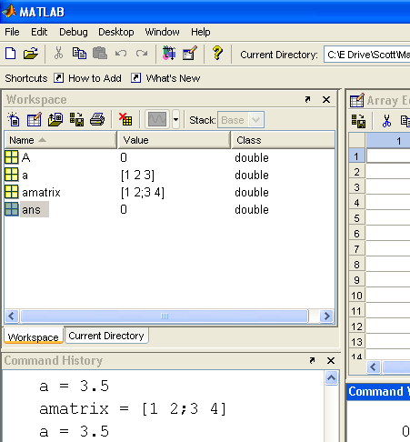
The Workspace Window
Listing Variables
Getting a high-precision look at their values by double-clicking on the variable

Slide 13
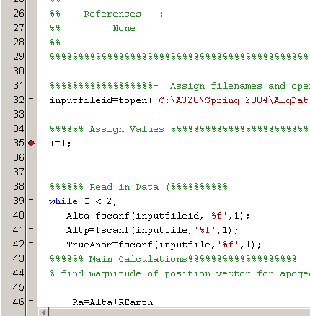
Debugging Menu
Setting Breakpoints
  When running program from Debug menu, will run until break point
  You may execute to next break, next step, etc.
  To remove a breakpoint, click on that point again
Will run to here and stop
Clicking here will set another breakpoint

Slide 14
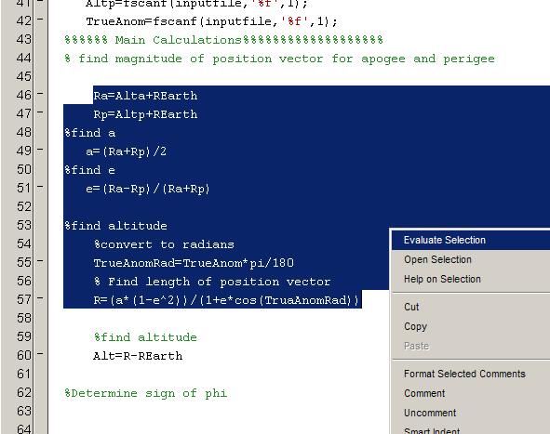
Evaluating Selections
In an m-file, highlight an area
Right click and choose “evaluate selection”

Slide 15
Summary
General Debugging Techniques
Matlab-Specific Debugging

